Slide 1
Personal Statement Writing for Reluctant Writers
Mary Webber and Jaden Reilly, Assistant Directors at the University of Alabama Writing Center

Slide 2
Agenda
Introductions
Aims
Writing Center Events and Resources
Strategies for Tutors
Example Personal Statements
Access Padlet

Slide 3
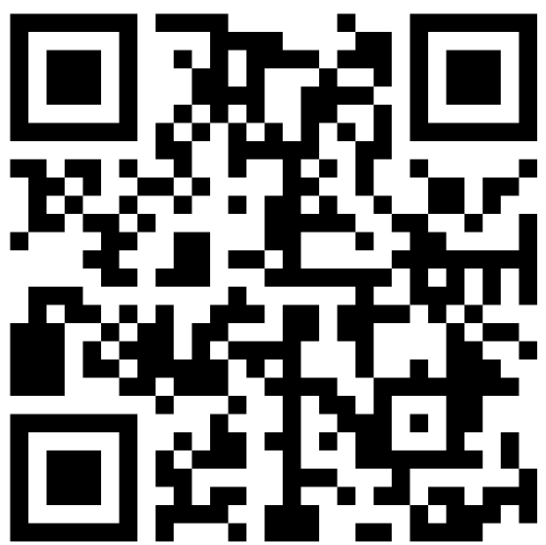
QR Code to Access Padlet
https://padlet.com/mmwebber/kysvc426pyz17auz

Slide 4
Introductions
What is you name?
Where are you from?
Do you work in a writing center? If so, where?
Have you ever written a personal statement? What was it like?
Have you ever reviewed personal statements on an admissions committee?

Slide 5
Aims
This workshop aims to
Address why many students struggle with personal statements
Provide tools and strategies for writing centers to support personal statement writers
Invite collaboration and discussion on how we can better support students

Slide 6
Why Personal Statements are Difficult
Many students are unfamiliar with personal statement writing
Personal statements are necessary for graduate school, scholarships and fellowships, medical school, and law school applications
Many applicants don’t see themselves as “good writers”
Lack of confidence combined with a largely unfamiliar genre makes personal statement writing uniquely daunting for many

Slide 7
Writing Center Events for Personal Statements
Workshops for applicants
  Application specific and general
  Collaboration with Office of External Scholarships and Fellowships
  Panel with admissions professionals from various fields
  Breakout rooms with tutors based on drafting stages
  Provide graphic organizers at workshops to help students begin the writing process
Workshops for tutors
  Workshops for tutors with admissions professionals so they know what makes a personal statement successful
  Peer support, provide time for tutors to discuss successes and struggles in personal statement appointments

Slide 8
What workshops or events has your writing center, or university in general, done to prepare students to write personal statements?

Slide 9
Strategies for Tutors

Slide 10
Common Issues
Students struggle to begin their personal statement
Students struggle to find meaningful anecdotes
Students struggle to show not tell, or they narrate their CV/resume
Their personal statement is too big or too small

Slide 11
Using Genre Moves
Move 1: Establish background –
  Move 1A (optional if Move 1B selected): Personal story with defining characteristic central to overall theme.
  Move 1B (optional if Move 1A selected): Describe earliest connection to desired program/field.
Move 2: Explain growth/skills gained/build in interest over time
Move 3: Make connections between translatable skills/knowledge and desired program/career
Move 4: Conclude on promising future if selected, using points established in prior moves.
Do you agree with these moves? What moves would you add or change based on your experience?

Slide 12
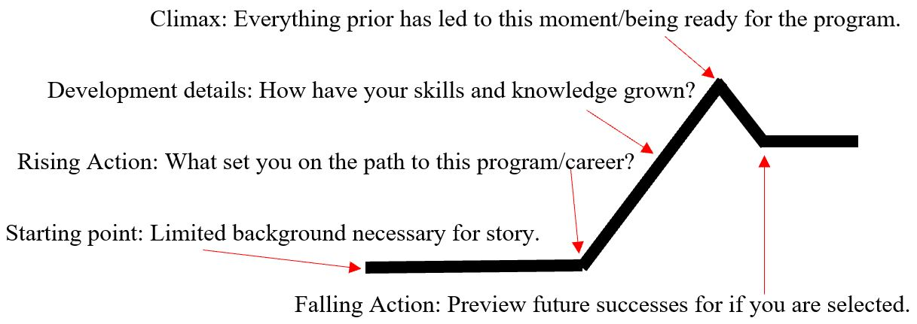
Visualizing

Slide 13

Visualizing
Winding road
Sections don’t necessarily have to be linear as long there is a common theme woven throughout

Slide 14
Can you think of other ways to visualize personal statements?

Slide 15
Guiding Questions
In 1-3 words, what is the theme of your paper?
How does this section/paragraph/anecdote relate to your theme?
What experience are you most proud of?
What are you discussing in other parts of your application?

Slide 16
What are some guiding questions you can ask to help personal statement writers?

Slide 17
Example Personal Statements
Look over one of the example personal statements
Discuss with a partner how you would support a student in improving that personal statement

Slide 18
Wrapping Up
Thank you for attending!
The Padlet will stay active for the foreseeable future if you wish to access it again
Special thanks to the UA Writing Center, IWCA
Stary Connected:
Mary Webber
mmwebber@crimson.ua.edu
linkedin.com/in/marymwebber
marywebber.com
Jaden Reilly
jtreilly@crimson.ua.edu

